Slide 1









Welcome to
Little Foxes
New Parents Meeting
WREN AND SPARROWS
23RD JUNE 2025

Slide 2






TODAY'S AGENDA:
  Introduction - who is who!
  Starting at Little Foxes
  What your child will need at Foxes
  Daily Routine
  Finance and Funding
  FAQs
  Dates of the Diary
  Q&A

Slide 3







Introduction
Head Teacher
Mr Simon Lockley
Early Years Lead
Early Years
Practitioners
Mrs Vicky Parker
Mrs Monica Coburn
Mrs Lauren Ramsey
Mrs Anna Rice
Mrs Amy Wyatt
Mrs Louise Wyatt
Deputy Managers
Miss Kinga Tulinska
Miss Chloe Davies
(on Maternity Leave)
Miss Abby Davies and Miss Mia Meek
Administrator
Mrs Kaylie Hooper

Slide 4

STARTING AT LITTLE FOXES
New Wrens
  Transition Sessions on Thursday 10th July or Monday 14th July 1pm - 2.30pm
  Home Visit between Wednesday 3rd and Friday 5th of September. Please sign up after the meeting!
  New Wrens will have a staggered start from Monday 8th of September.
New Sparrows
  Transition Sessions on Thursday 10th July or Monday 14th July 1pm - 2.30pm
  No home visit
  New Sparrows will start with their usual hours from Monday 8th of September.
We usually find most children settle best starting their routine early. However if you feel your child may need a slower start to Foxes please do get in touch and we can discuss with you!

Slide 5


WHAT YOUR CHILDREN WILL NEED
  A pair of named wellies and all in one weather suit to stay at Foxes
  A named bag with a change of clothing or two.
  Enough nappies, wipes and nappy bags for the whole session if needed.
  A named lunchbox if staying all day.
  Snack pot for each session if not taking up snack fee
In the summer
  Sunhat and suncream.
In the winter
  Warm coat, gloves and hat.
We play outside in all weathers and we can get wet and messy all year round.
Please don’t send children in anything you want to keep tidy!

Slide 6
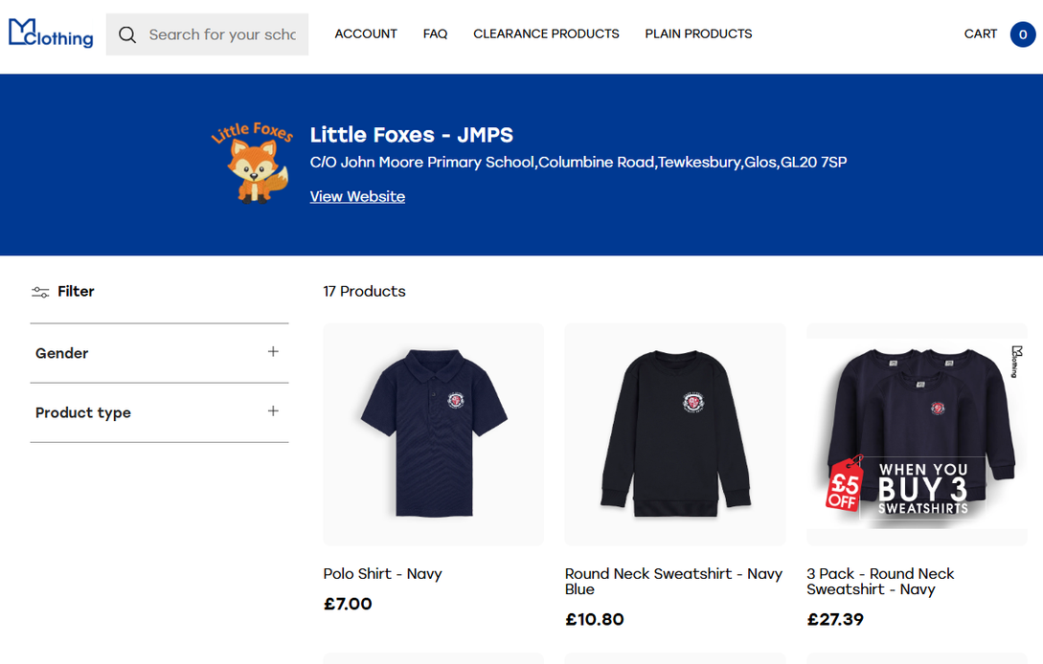
UNIFORM
We do have a uniform supplier called MyClothing. We do get a small donation from each purchase.
Uniform is not compulsory!

Slide 7
DAILY ROUTINE
8.40am - 8.50am Soft Opening and ‘VIP’ Time
Carpet time session to say hello to everyone
10.30am Snack Time
11pm More Play Time
11.30am Carpet time and saying goodbye to our Morning Friends
12pm Lunchtime!
12.20pm Afternoon Children arrive
1pm On the Big Field!
2pm Snack Time
2.30pm Carpet time ready for home time
Please collect children by 2.50pm at the latest!

Slide 8

PACKED LUNCHES
Please provide a balanced packed lunch for your child
Please note
  No nuts/nut spreads or chocolate spreads!
  No sweeties or chocolates

Slide 9

FINANCES AND FUNDING
All 3 year old are entitled to 15 hours a week funded from the term AFTER they turn 3
WORKING FAMILY FUNDING
If you are eligible for this funding children are entitled to 30 hours funding a week from 9 months old.
You need to apply by August 31st for September!
Funding has to be reconfirmed every 3 months, you will get an email from HMRC as a reminder.
If your funding elapses or you do not apply on time you will have to pay for your place with us
ACHIEVING 2 YEAR OLD FUNDING
Families who have certain government benefits are entitled to up to 15 hours from 2 years old.
If you think you may be eligible, you can apply through the Gloucestershire Citizens Portal. Please get in touch if you would like more information or help with your application

Slide 10

FINANCES AND FUNDING
PAID HOURS
If you will be paying for your place with us.
From September 2025 our hourly rates are:
2 year old - £7.50
3 year old - £6.00
Invoices are sent monthly in advance and payment is due before the month begins.
SNACK FEE
We charge a small fee of 25p per session and we can accommodate any food preferences or allergies.
We waive this fee for Pupil Premium children.

Slide 11






DATES FOR THE DIARY
Thursday 10th or Monday 14th July
Transition Sessions
Monday 14th July
Deadline to return paperwork to Little Foxes
Please bring Birth Certificate
31st August
Deadline to Apply for Working Family Funded hours for September
Wednesday 3rd September to Friday 5th September
Wren Home Visits
From Monday 8th September
Starting at Little Foxes
Please check paperwork for your child’s start date!
Friday 19th October
INSET DAY
Little Foxes Closed
Monday 27th October to Friday 31st October
HALF TERM
Little Foxes Closed

Slide 12

IN YOUR PACK
Registration Form
Please bring this back by Monday 14th of July with your child’s birth certificate
Terms and Conditions
Please sign and return the loose page agreeing to our T+Cs
‘About Me’
Wrens - Please have ready for your home visit
Sparrows - Please have ready for your transition session
Parent Handbook
Term Dates for Academic Year 2025
Payment Dates for Academic Year 2025

Slide 13


Q&A
Parent Comments
my daughter felt very welcome and positive from day 1’
‘my daughter was upset when she started but the team reassured us with
messages and photos’
‘the opportunities that they have are great.
Forest school, gym and all the equipment I see set up daily.
I think this will make the move to primary so smooth!’
‘good balance between structures adult led learning and child led being at
preschool has really developed their confidence and progressed their learning’
‘Teachers make little ones feel secure and confident and safe’
‘Staff were very patient and kind with my child.
Allowing him to find his feet in his own time’
‘my child seems happy and enjoys all the activities that are on offer’
‘love that each child is helped and encouraged to shine in their own way as
all the children are different’
‘thank you for all the hard work that the key workers put into helping my
children. They always go above and beyond and it really does show’

